Slide 1

EE150 Signals and Systems
Tutorial 14
Guorui Cui
Shanghaitech University
Jun 2024
Tutorial 14
EE 150
Jun 2024

Slide 2
Outline
Outline
1. HW6
2. Z Transform
Tutorial 14
EE 150
Jun 2024

Slide 3
01
HW6
1. HW6
Tutorial 14
EE 150
Jun 2024

Slide 4
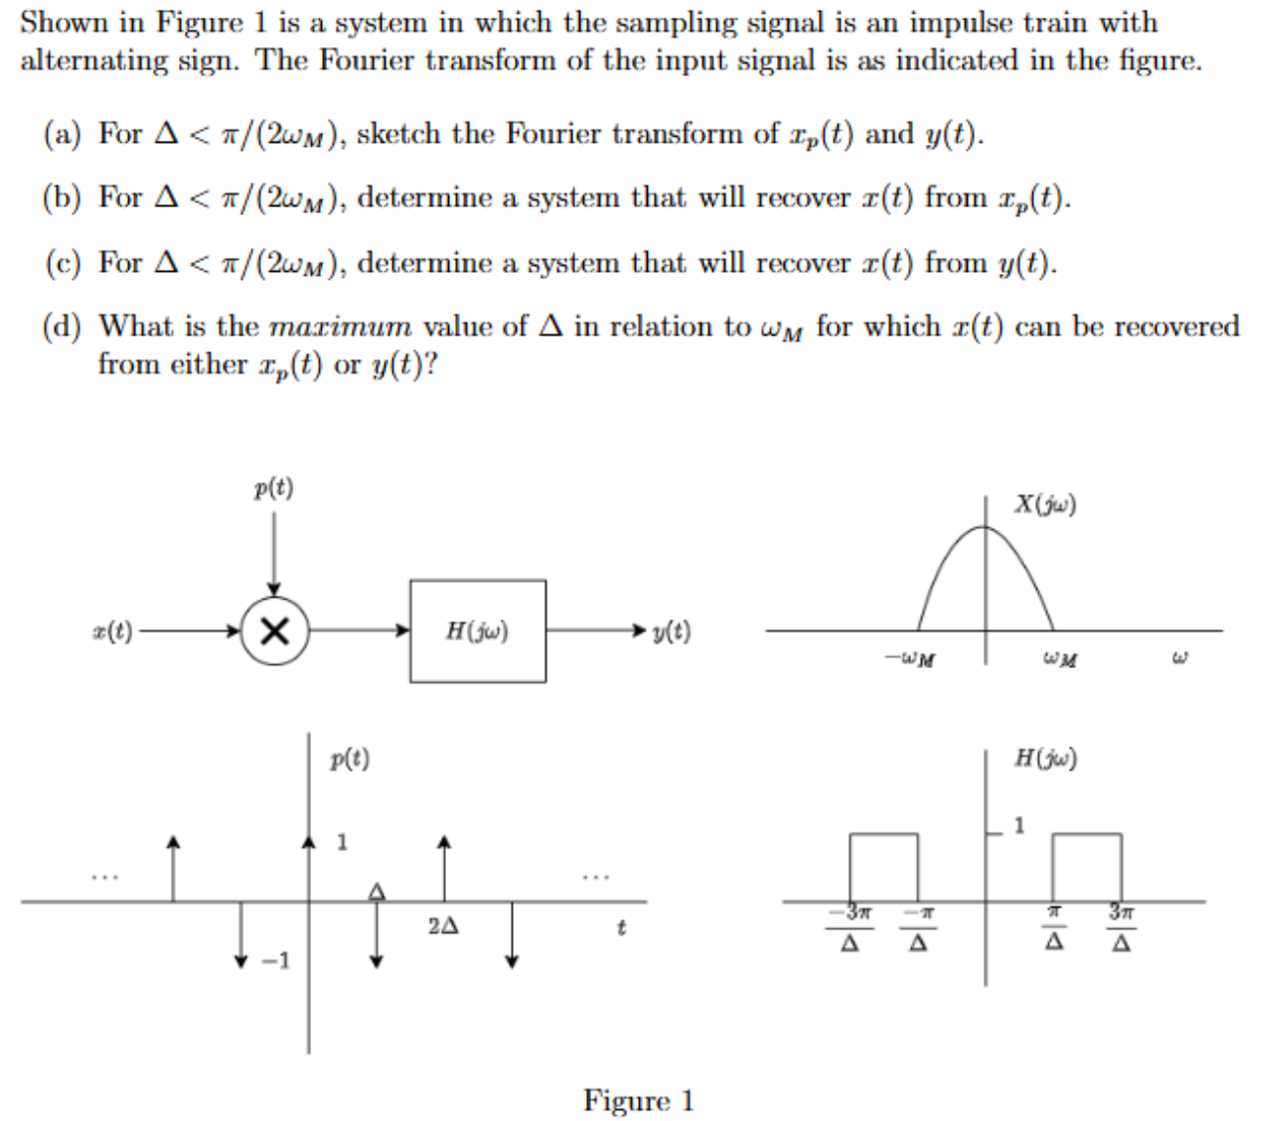
01
HW6
E1
Tutorial 14
EE 150
Jun 2024

Slide 5
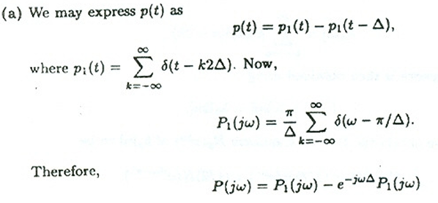
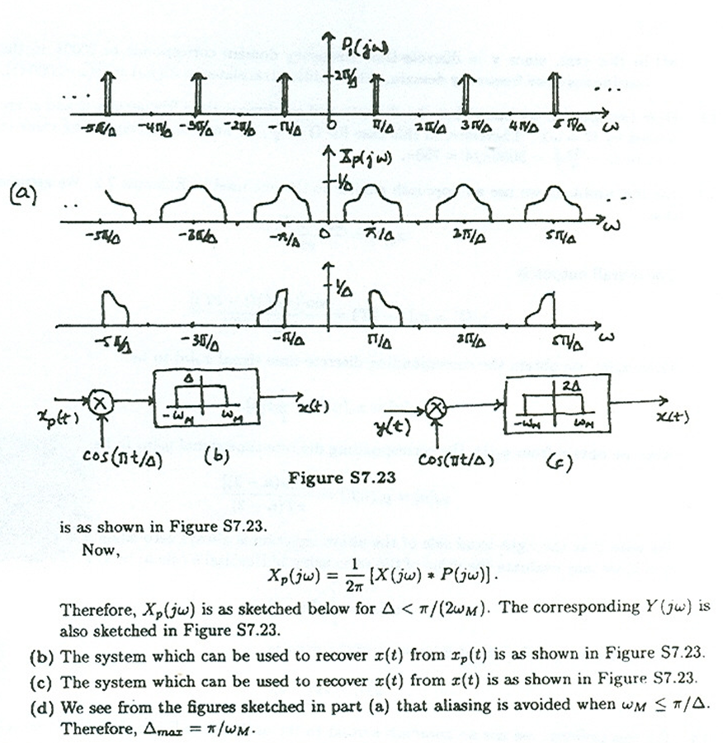
01
HW6
Tutorial 14
EE 150
Jun 2024

Slide 6
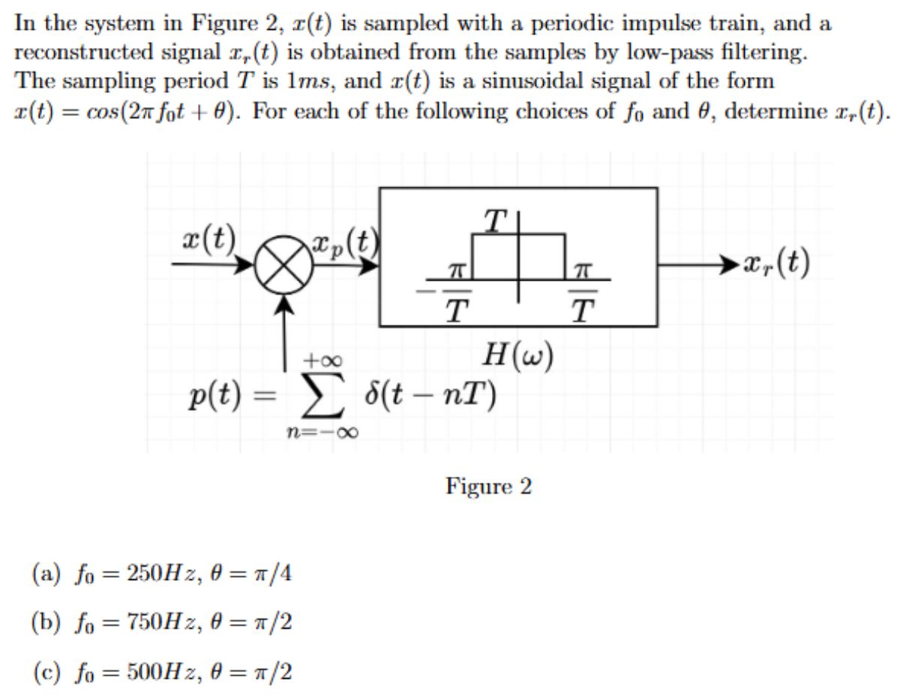
01
HW6
E2
Tutorial 14
EE 150
Jun 2024

Slide 7
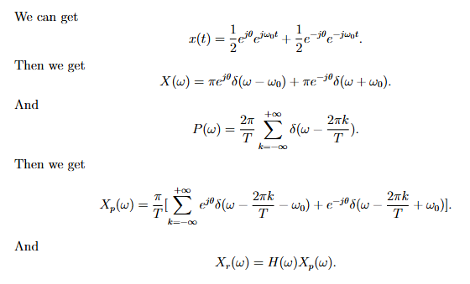
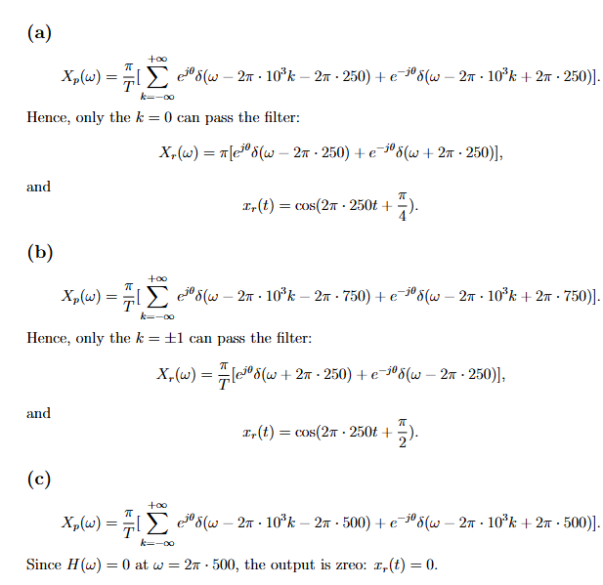
01
HW6
Tutorial 14
EE 150
Jun 2024

Slide 8
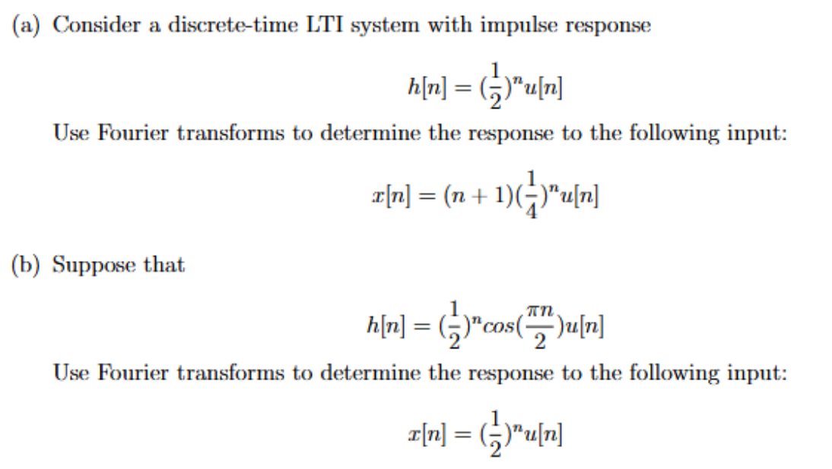
01
HW6
E3
Tutorial 14
EE 150
Jun 2024

Slide 9
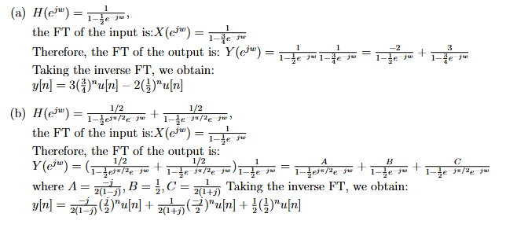
01
HW6
Tutorial 14
EE 150
Jun 2024

Slide 10
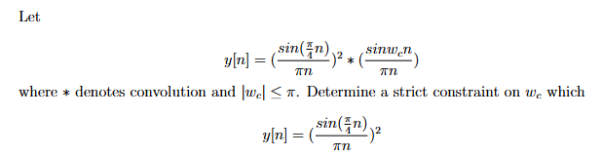
01
HW6
E4
Tutorial 14
EE 150
Jun 2024

Slide 11
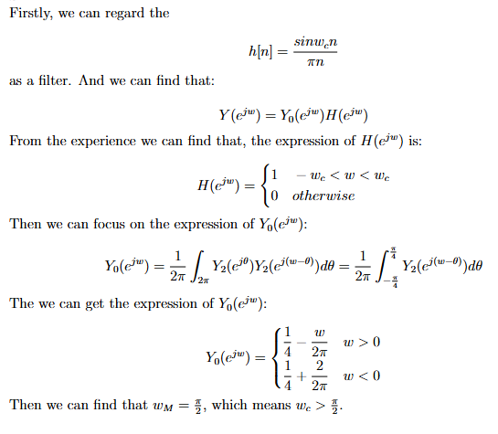
01
HW6
Tutorial 14
EE 150
Jun 2024

Slide 12
02
Z Transform
2. Z Transform
Tutorial 14
EE 150
Jun 2024

Slide 13
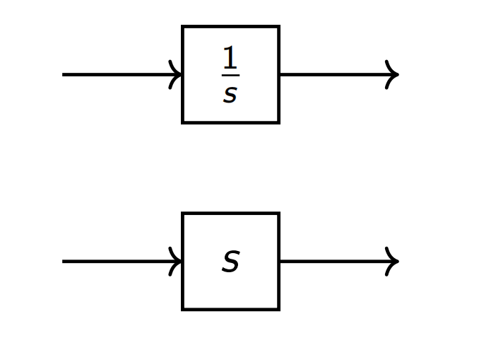

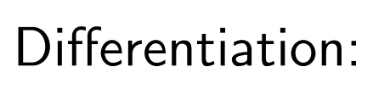
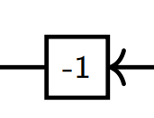
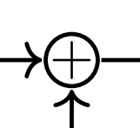
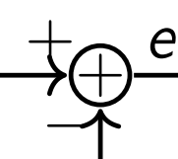
02
Z Transform
Possible circuits
Mutiply constant:
Add:
Tutorial 14
EE 150
Jun 2024

Slide 14
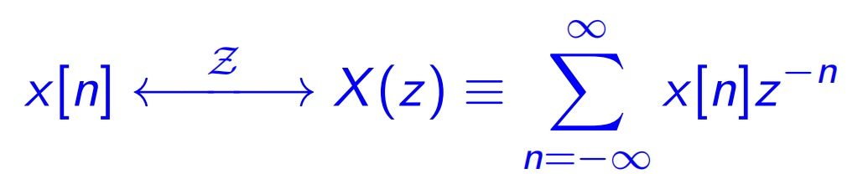
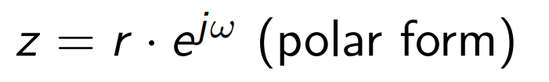
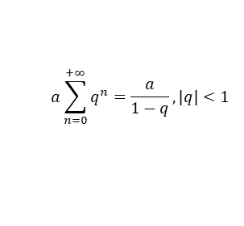
02
Z Transform
Note: z-transform only can be applied on discrete signals.
The function X(z) is continous.
Usually this equation is useful:
$$a\sum_{n=0}^{+∞}{q^{n}}=\frac{a}{1−q},|q|<1$$
Tutorial 14
EE 150
Jun 2024

Slide 15

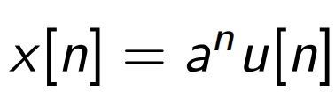
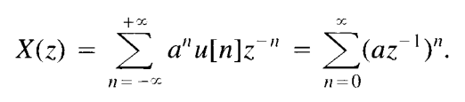

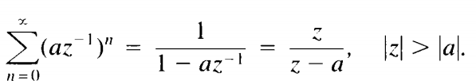
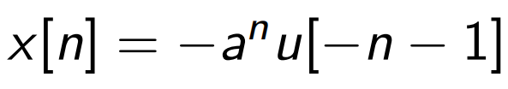
02
Z Transform
Just like LT, different signals may lead to the same function in z, but their ROC is different.
Tutorial 14
EE 150
Jun 2024

Slide 16
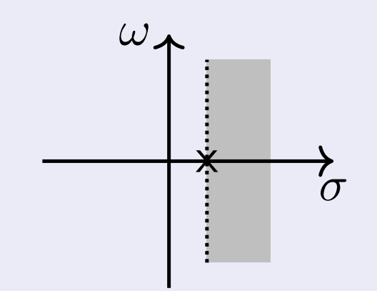
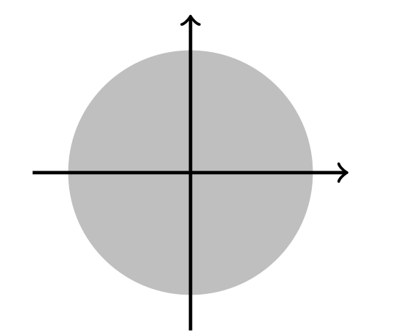
02
Z Transform
Note: ROC of LT and ZT give restriction on different form.
ROC of LT is a strip, has restriction on Re(s)
ROC of ZT is a circle/ring, has restriction on |z|
Tutorial 14
EE 150
Jun 2024

Slide 17
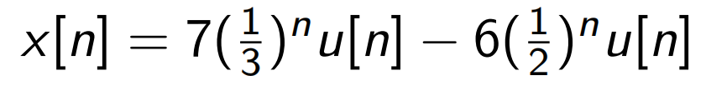
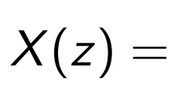
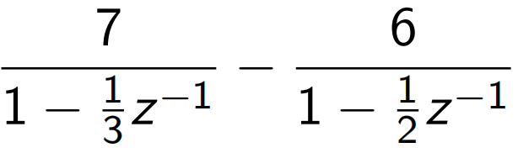
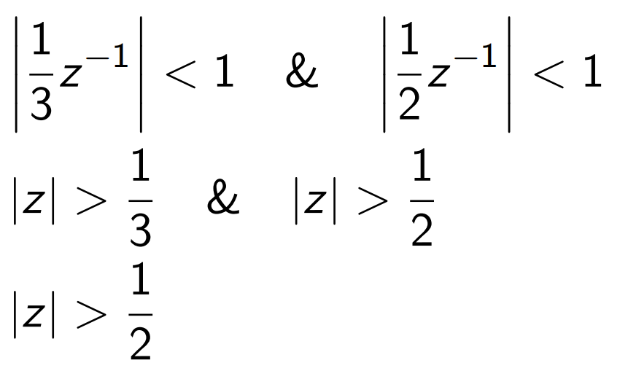
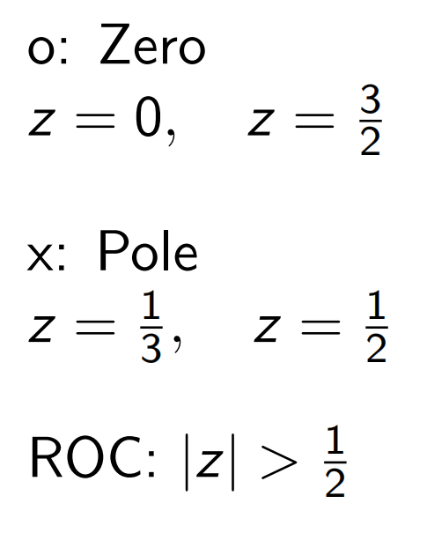
02
Z Transform
Zero and Pole
zero:z so that numerator=0
pole:z so that denominator=0
ROC should not contain poles, both possible whether contains zeros.
Tutorial 14
EE 150
Jun 2024

Slide 18
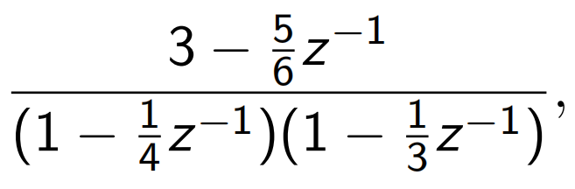
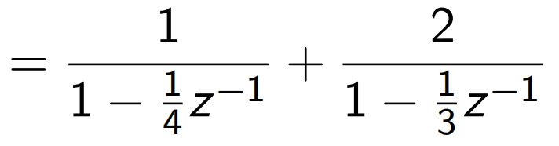
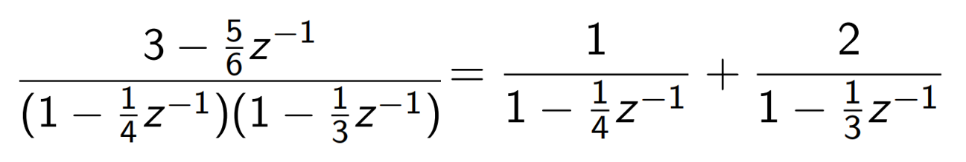


02
Z Transform
Partial Fraction Expansion
Recommend:Undetermined coefficient(待定系数法)
What if the denominator cannot be decomposited into ratonal function?
Tutorial 14
EE 150
Jun 2024

Slide 19
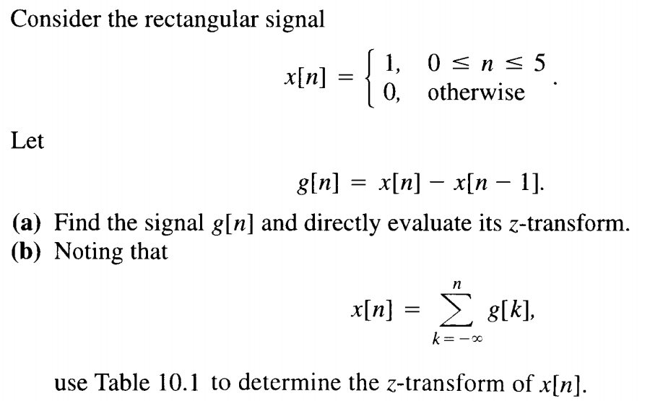

02
Z Transform
Ex1.
Tutorial 14
EE 150
Jun 2024

Slide 20
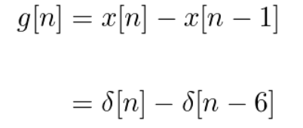

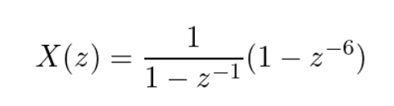

02
Z Transform
Tutorial 14
EE 150
Jun 2024

Slide 21
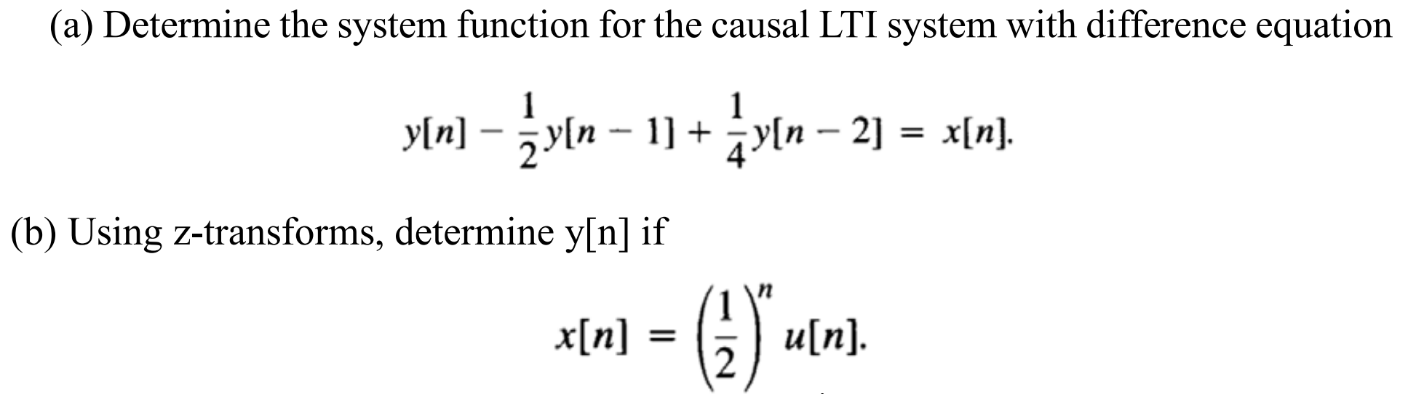
02
Z Transform
Ex2.
Tutorial 14
EE 150
Jun 2024

Slide 22
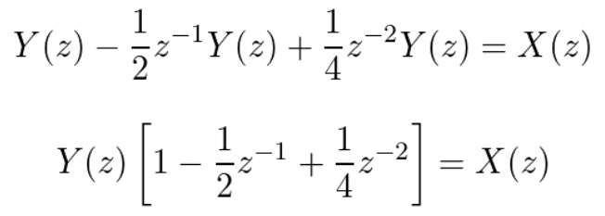
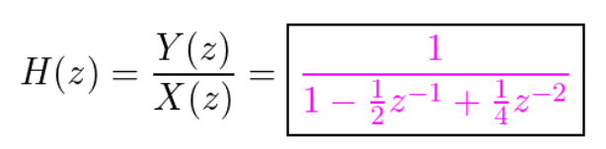
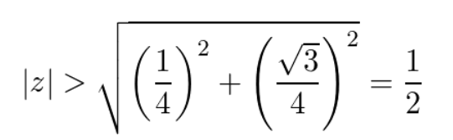
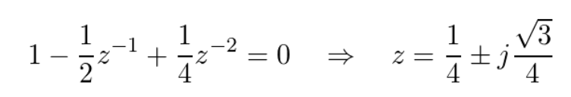
02
Z Transform
Ex.
Tutorial 14
EE 150
Jun 2024

Slide 23
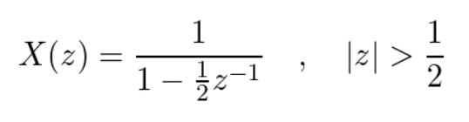

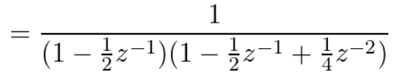
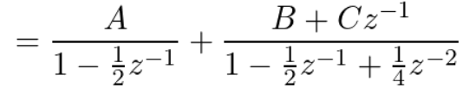
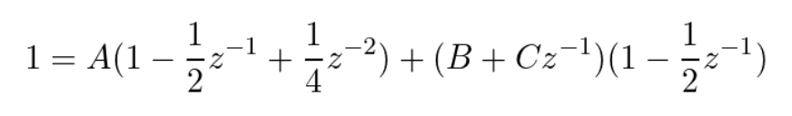
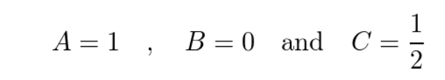
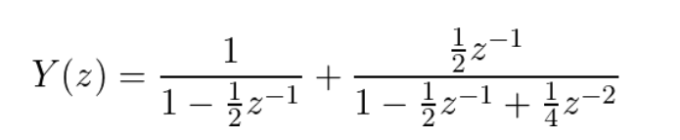

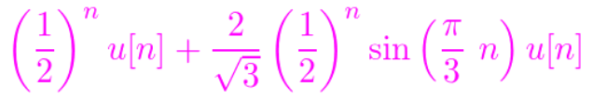
02
Z Transform
Tutorial 14
EE 150
Jun 2024

Slide 24
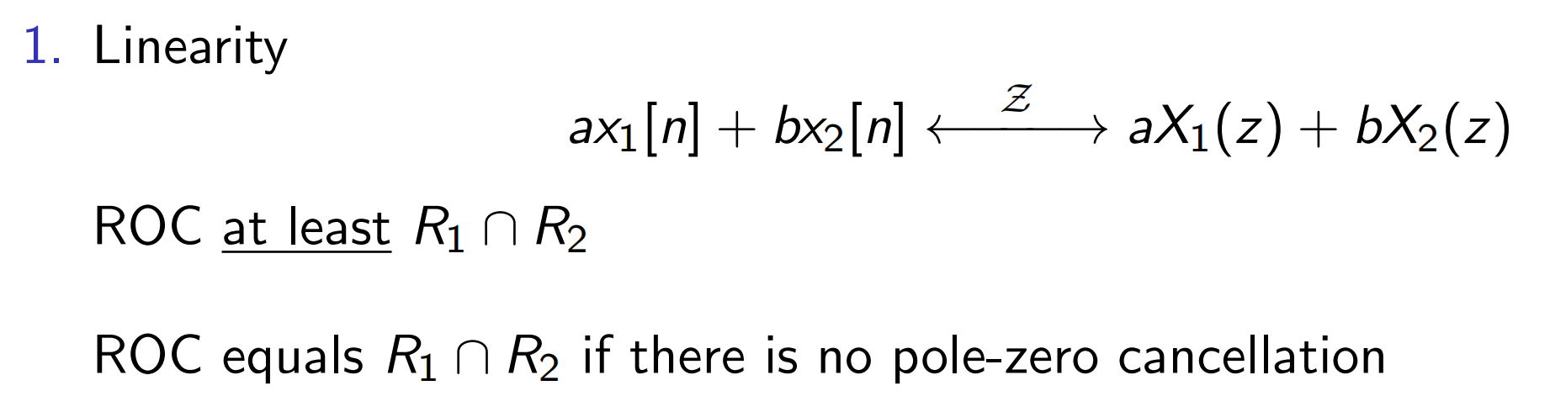
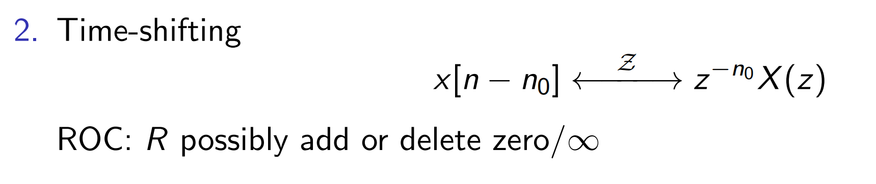
02
Z Transform
Consider A(z)+B(z) while A(z)=-B(z)
Consider X(z)=F(z)z^{m} with m=0 or n₀
Tutorial 14
EE 150
Jun 2024

Slide 25
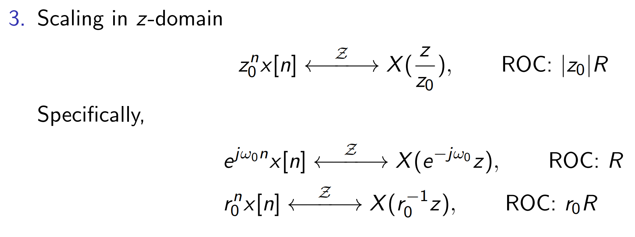

02
Z Transform
Tutorial 14
EE 150
Jun 2024

Slide 26



02
Z Transform
Consider A(z)*B(z) while A(z)=1/B(z)
Tutorial 14
EE 150
Jun 2024

Slide 27



02
Z Transform
Tutorial 14
EE 150
Jun 2024

